Slide 1


Comparing classic and primitive-based versions of kinodynamic RRT*
Autonomous and Mobile Robotics
Final Project
Academic Year 2021/2022
Professor: Giuseppe Oriolo
Supervisor: Paolo Ferrari
Students:
Lorenzo Mattia 1793272 Michela Proietti 1739446
Sofia Santilli 1813509

Slide 2
Motion Planning Problem
Additional requirements
Differentially constrained systems
Optimal
Kynodynamic
Guaranteed optimality of resulting trajectories
Guaranteed feasibility of resulting trajectories
Collision-free path between an initial and a final configuration

Slide 3
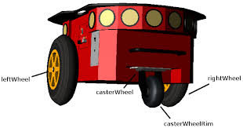
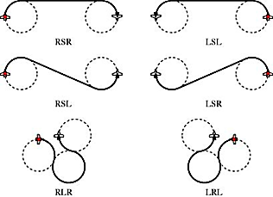
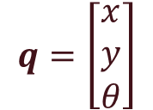
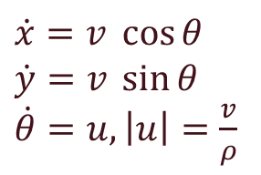
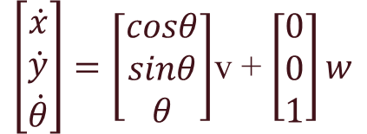
Problem statement
Configuration:
Kinematic model:
Pioneer p3dx
Unicycle
$$q=\left[\begin{aligned}x \\ y \\ θ\end{aligned}\right]$$
$\left[\begin{aligned}\dot{x} \\ \dot{y} \\ \dot{θ}\end{aligned}\right]=\left[\begin{aligned}cosθ \\ sinθ \\ θ\end{aligned}\right]$v + $\left[\begin{aligned}0 \\ 0 \\ 1\end{aligned}\right]w$
Dubins’ vehicle
$\dot{x}=v \cos{θ}$
$\dot{y}=v \sin{θ}$
$\dot{θ}=u, \left|u\right|=\frac{v}{ρ}$
System’s dynamics:
Motion planning problem: find the optimal path, feasible for the system dynamics, connecting two configurations $q_{ini}$ and $q_{goal}$

Slide 4
Randomly exploring Random Trees
Comparison between two implementations
RRT*
Primitive-based RRT*
Continuous configuration space
Multiple invocations of the steering function
Discretized configuration space
Precomputed catalogue of primitives

Slide 5



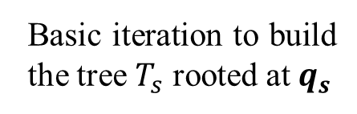
Classic RRT*
Basic iteration to build the tree $T_{s}$ rooted at $q_{s}$
Randomly sample $q_{rand}$
Search $q_{nearest}$ in the tree
If not collision-free
Find a feasible trajectory between $q_{nearest}$ and $q_{rand}$, invoking the steering function
If collision-free
Compute the set $Q_{near}$ of the nearest neighbours to $q_{rand}$
Choose as parent of$q_{rand}$ the node in $Q_{near}$ with the lowest cost from the root
Rewire the tree

Slide 6
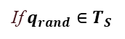

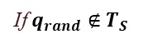
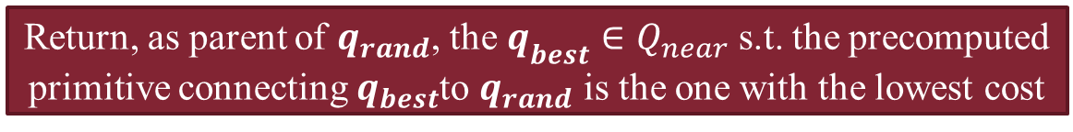


Primitive-based RRT*
Basic iteration to build the tree $T_{s}$ rooted at $q_{s}$
Randomly sample $q_{rand}$
If not collision-free
Compute the set $Q_{near}$ of the nearest neighbours to $q_{rand}$
Return, as parent of $q_{rand}$, the $q_{best}∈Q_{near}$ s.t. the precomputed primitive connecting $q_{best}$to $q_{rand}$ is the one with the lowest cost
If collision-free
If $q_{rand}∉T_{S}$
If $q_{rand}∈T_{S}$
Insert $q_{rand}$ in the tree, with parent $q_{best}$
Update $q_{rand}$ with new parent $q_{best}$
Rewire the tree

Slide 7



Implementation: working environment
Ubuntu 18.04
CoppeliaSim 4.0 EDU
C++

Slide 8
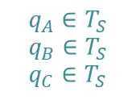
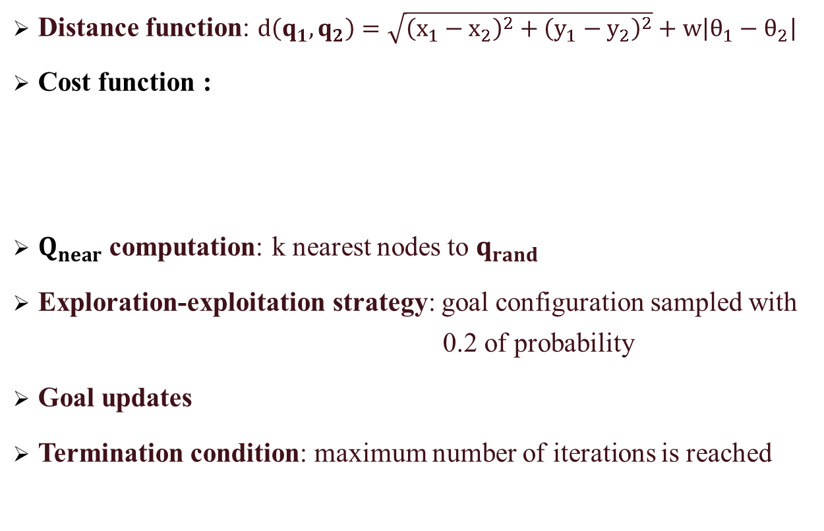
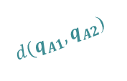
Implementation: basic functions
Distance function: $d\left(q_{1}, q_{2}\right)=\sqrt{{\left(x_{1}−x_{2}\right)}^{2}+{\left(y_{1}−y_{2}\right)}^{2}}+w\left|θ_{1}−θ_{2}\right|$
Cost function :
$Q_{near}$ computation: k nearest nodes to $q_{rand}$
Exploration-exploitation strategy: goal configuration sampled with 0.2 of probability
Goal updates
Termination condition: maximum number of iterations is reached
q_{A2}
$$q_{A}∈T_{S}$$
$$q_{B}∈T_{S}$$
$$q_{C}∈T_{S}$$
q_{A1}
q_{B}
q_{C}
q_{A}
$d(q_{A1},q_{A2}$)

Slide 9
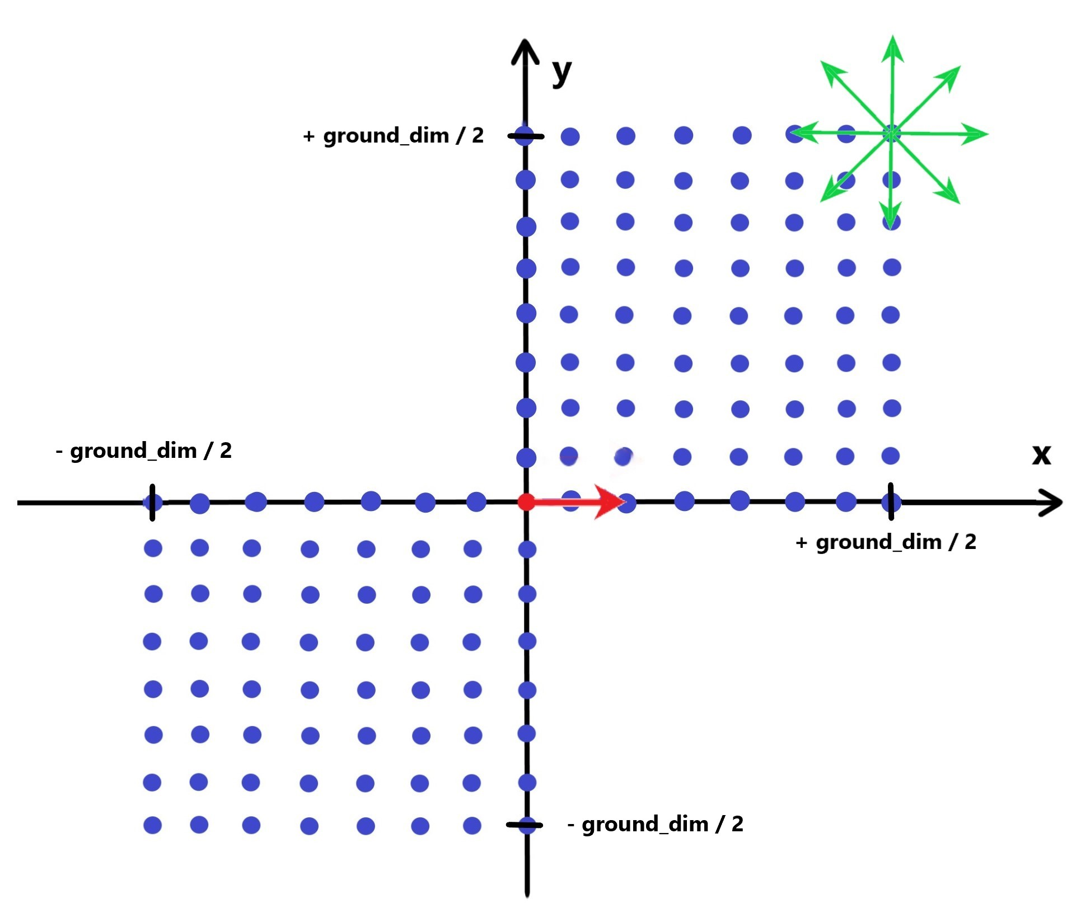
Implementation: catalogue of primitives
Precomputation of the catalogue of primitives:
saved in a text file, with rows in the format (final node, cost, path)

Slide 10
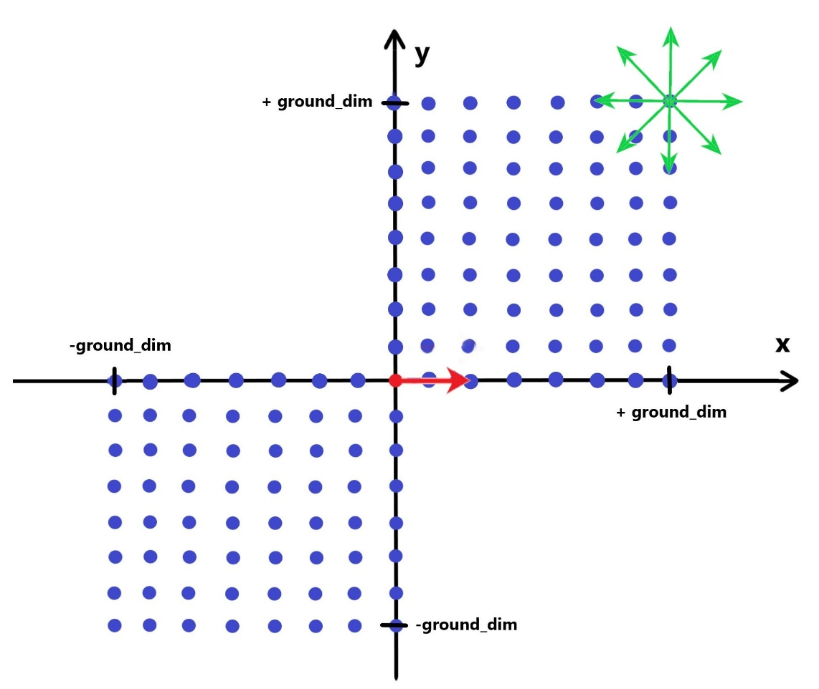
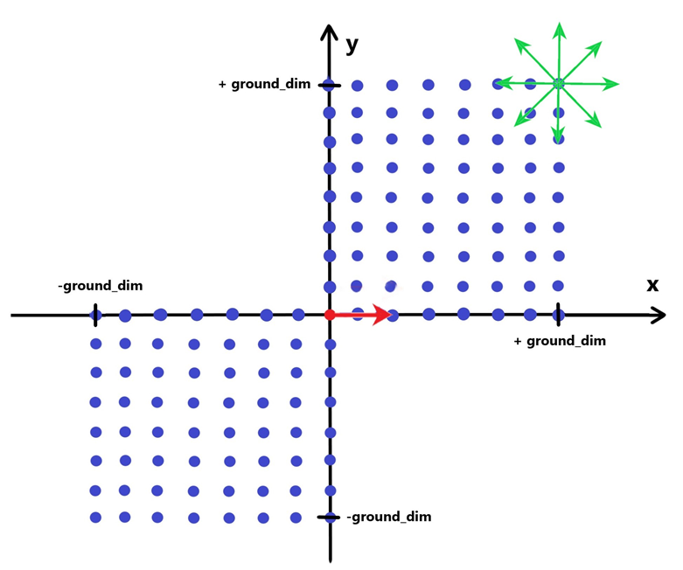
Implementation: primitive’s selection
q_{A}=(-2, 3, -90)
(2, 1, 210)
q_{B}=(-3, 1, 120)
(0, 0, 0)
(0, 0, -90)
(-1, -2, 120)
(2, -1, 210)

Slide 11
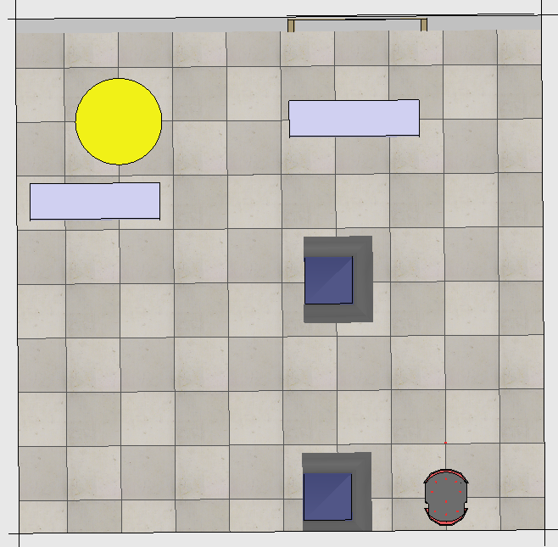
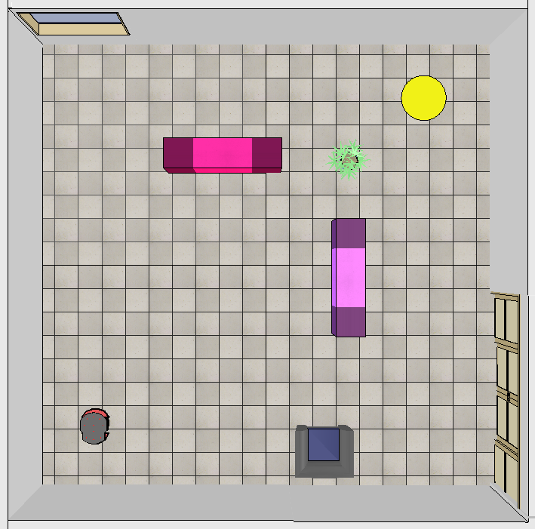
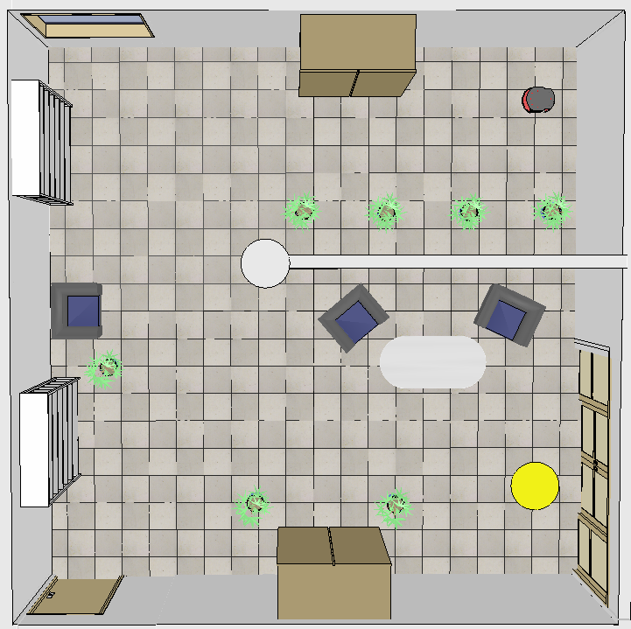
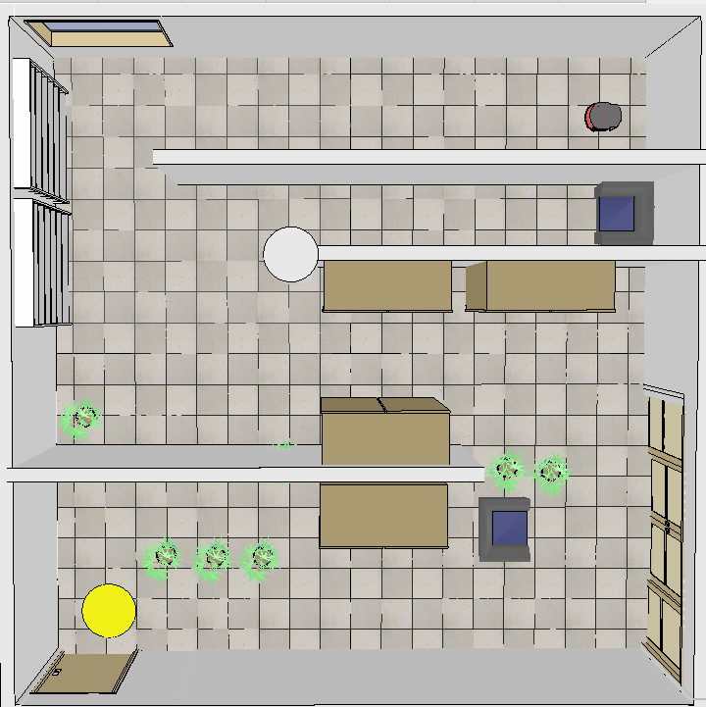
Planning experiments: scenarios
Four simulation environments of increasing complexity
Three different combinations of grid resolutions and possible orientations, for the primitive based version
Scene 1
Dimension: 5x5 [m]
Scene 2
Dimension: 10x10 [m]
Scene 3
Dimension: 10x10 [m]
Scene 4
Dimension: 10x10 [m]
Grid res. | #orientations
1 | 4
1 | 8
0.5 | 8
Grid res. | #orientations
4 | 4
1 | 8
0.5 | 8
Grid res. | #orientations
4 | 4
1 | 8
0.5 | 8
Grid res. | #orientations
4 | 4
1 | 8
0.5 | 8

Slide 12
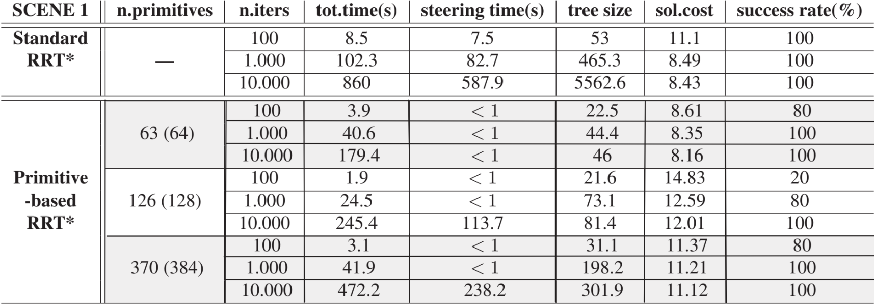
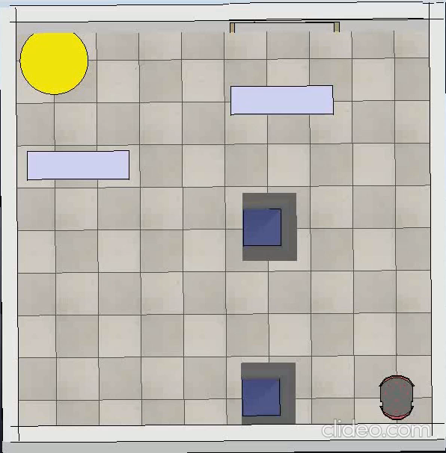
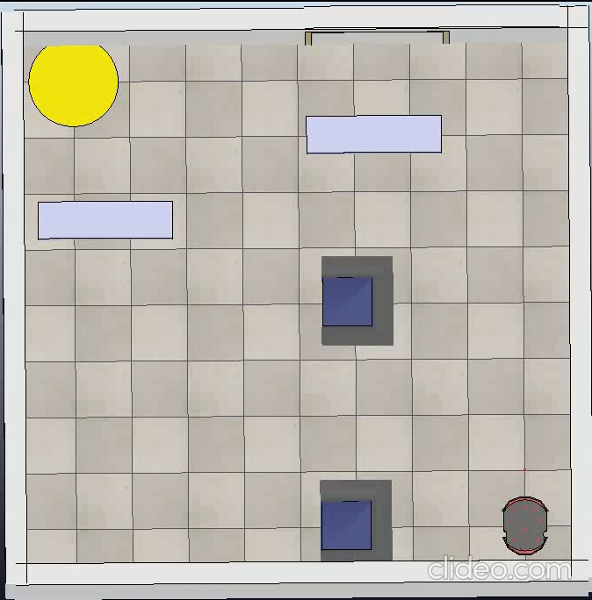
Scene 1
Classic RRT*
Primitive-based
RRT*
Classic RRT*

Slide 13

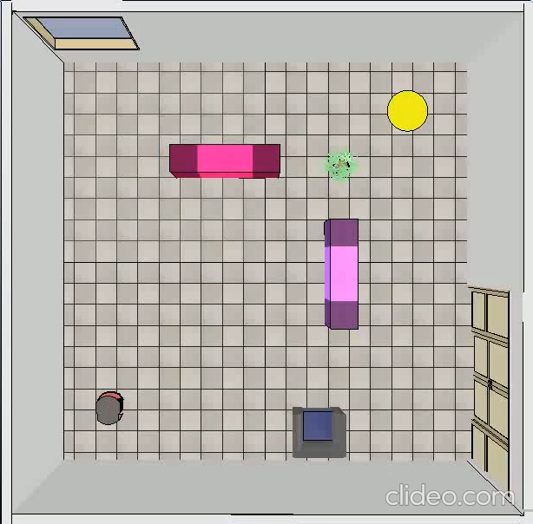
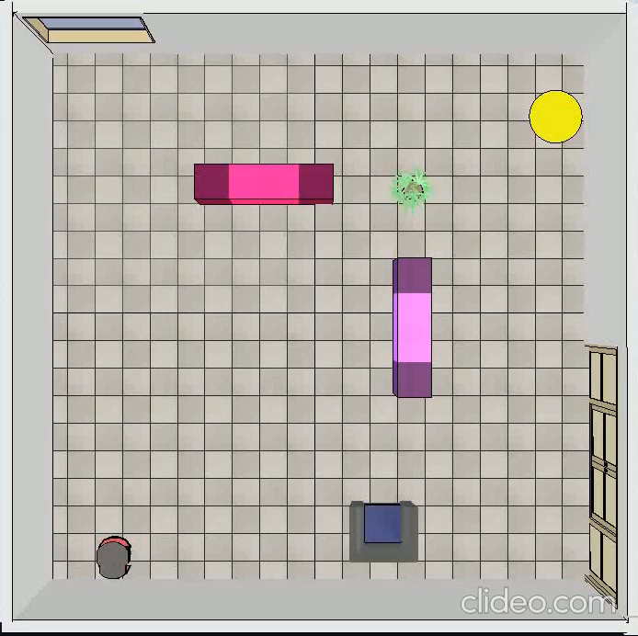
Scene 2
Classic RRT*
Primitive-based
RRT*
Classic RRT*

Slide 14
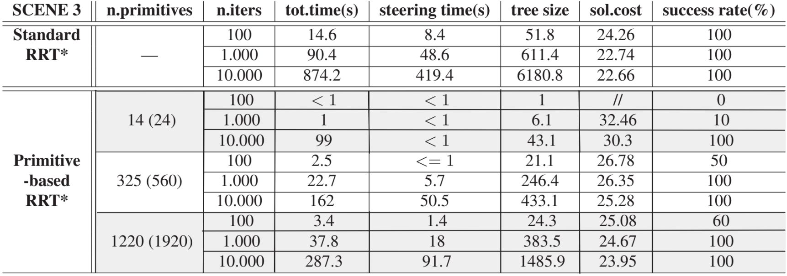
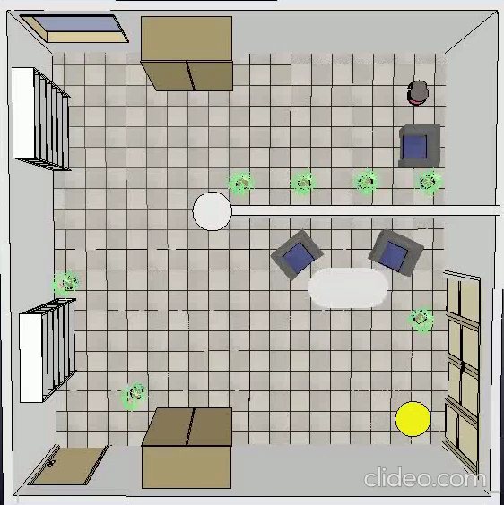

Scene 3
Classic RRT*
Primitive-based
RRT*
Classic RRT*

Slide 15
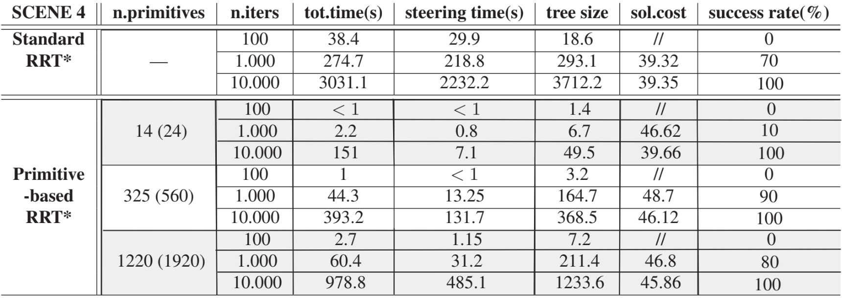
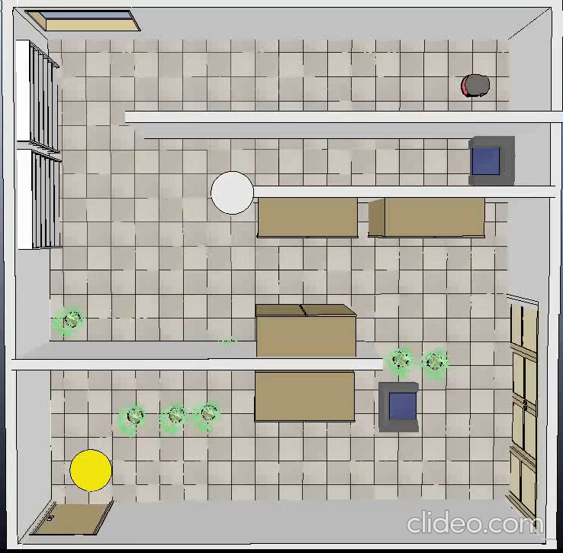
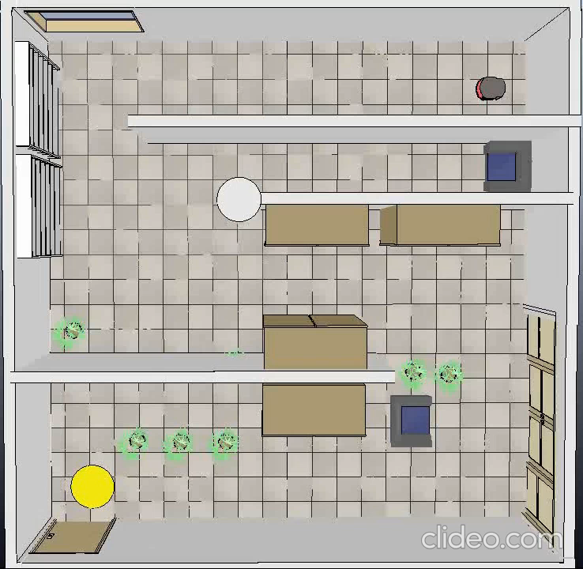
Scene 4
Classic RRT*
Primitive-based
RRT*
Classic RRT*

Slide 16
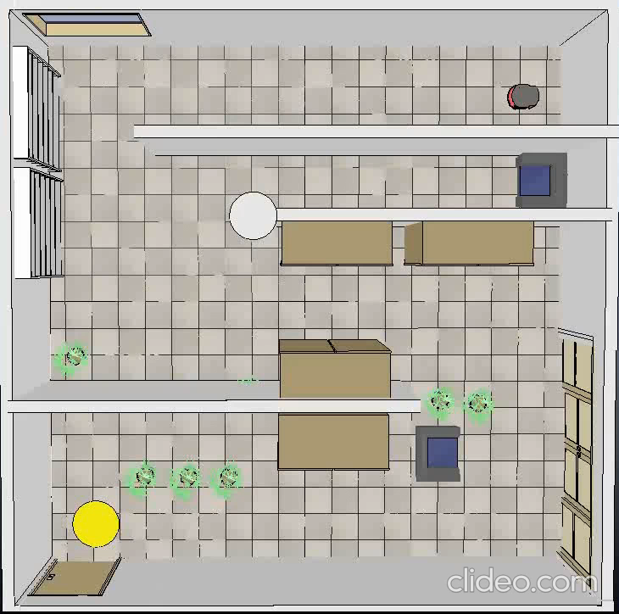
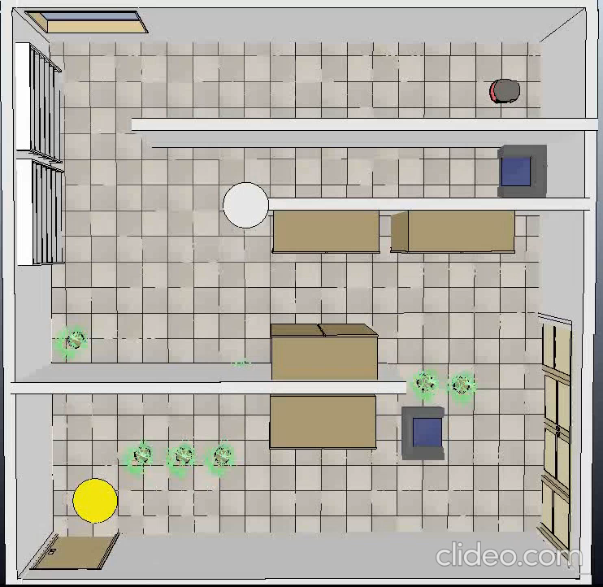
Scene 4
Comparison varying the catalogue
Grid resolution: 4
4 orientations
Grid resolution: 1
8 orientations
Grid resolution: 0.5
8 orientations

Slide 17
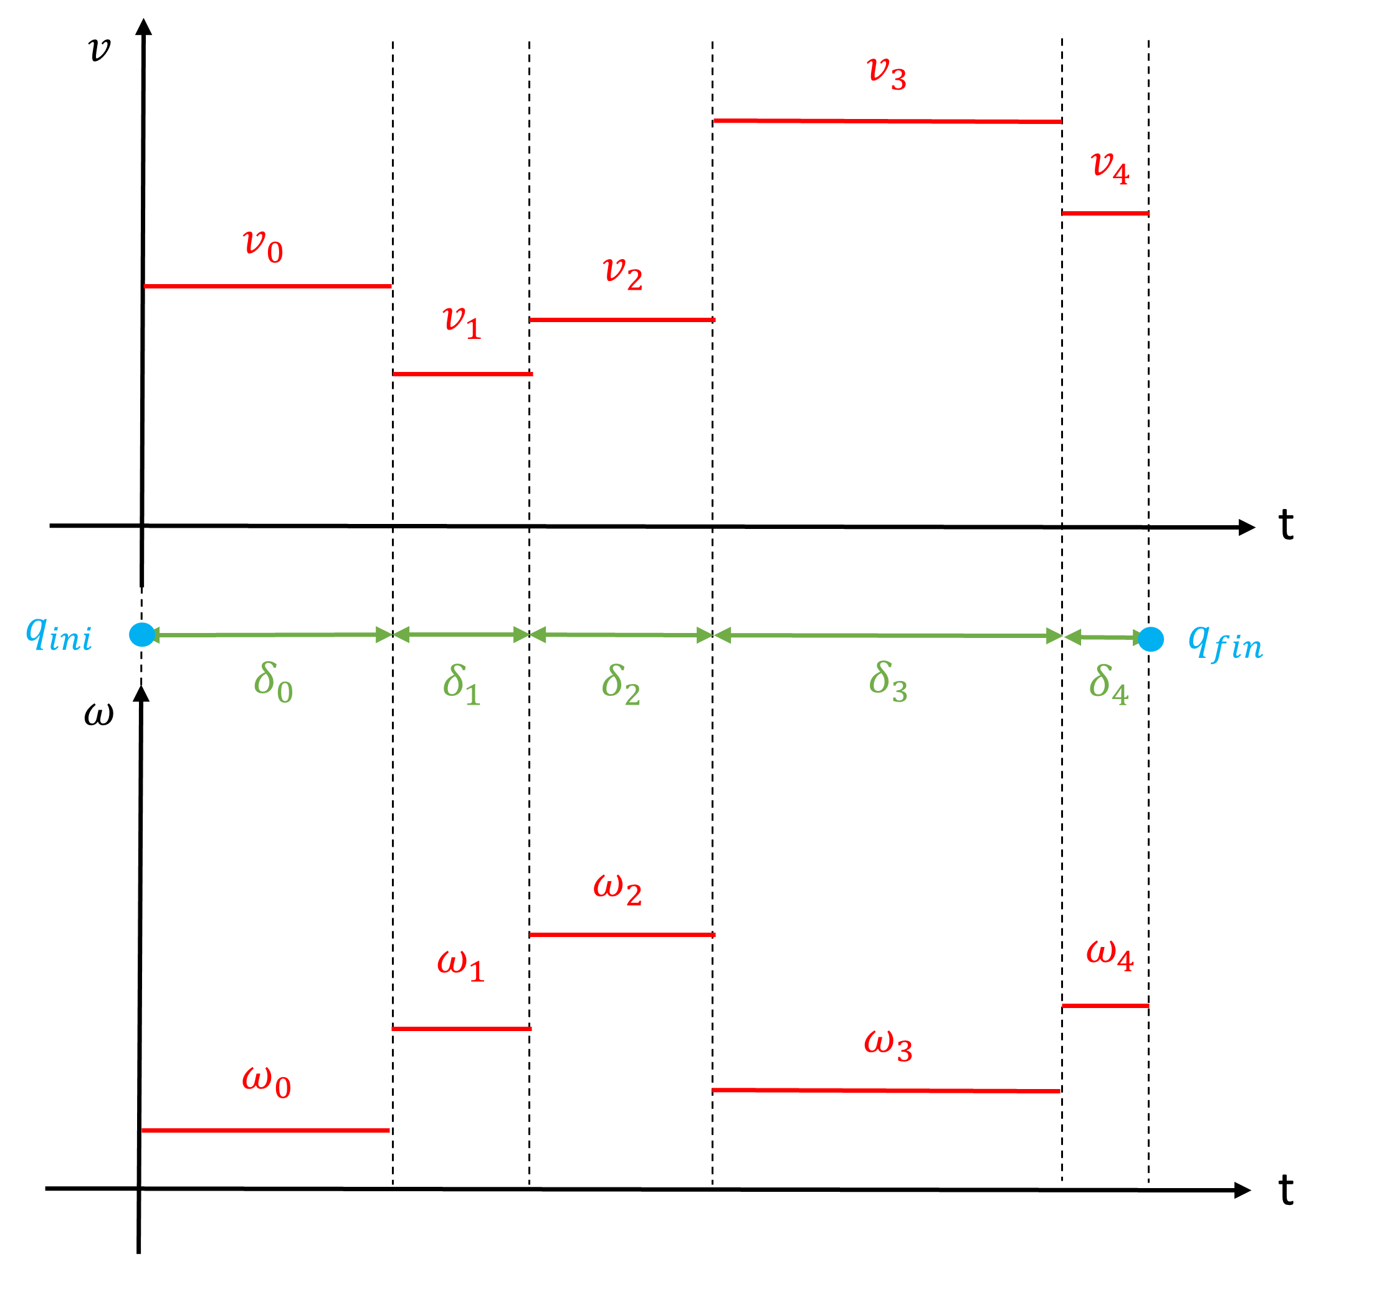
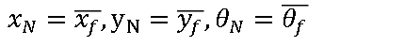
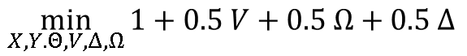
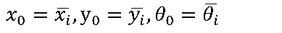
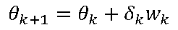
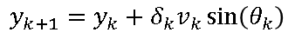

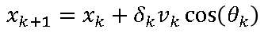
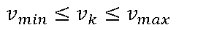
Extension to generic unicycle
The steering function requires to solve TPBVP: compute the best path between two nodes that satisfies a constrained optimality
$$\min_{X, Y. Θ, V, Δ, Ω}{1+0.5 V+0.5 Ω+0.5 Δ}$$
$x_{k+1}=x_{k}+δ_{k}v_{k}\cos\left(θ_{k}\right)$
$y_{k+1}=y_{k}+δ_{k}v_{k}\sin\left(θ_{k}\right)$
$θ_{k+1}=θ_{k}+δ_{k}w_{k}$
s.t.
$x_{0}=\overline{x_{i}}, y_{0}=\overline{y_{i}}, θ_{0}=\overline{θ_{i}}$
$x_{N}=\overline{x_{f}}, y_{N}=\overline{y_{f}}, θ_{N}=\overline{θ_{f}}$
$v_{min}≤v_{k}≤v_{max}$
$w_{min}≤w_{k}≤w_{max}$
Executed in the steering function of the algorithm and solved through Ifopt, a light-weight, Eigen-based C++ interface to Nonlinear Programming solvers

Slide 18
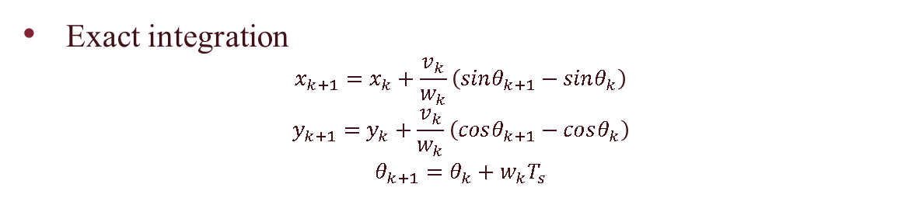
TPBVP: trajectory reconstruction
Exact integration
$$x_{k+1}=x_{k}+\frac{v_{k}}{w_{k}}\left(sinθ_{k+1}−sinθ_{k}\right)$$
$$y_{k+1}=y_{k}+\frac{v_{k}}{w_{k}}\left(cosθ_{k+1}−cosθ_{k}\right)$$
$$θ_{k+1}=θ_{k}+w_{k}T_{s}$$
Final maneuver

Slide 19
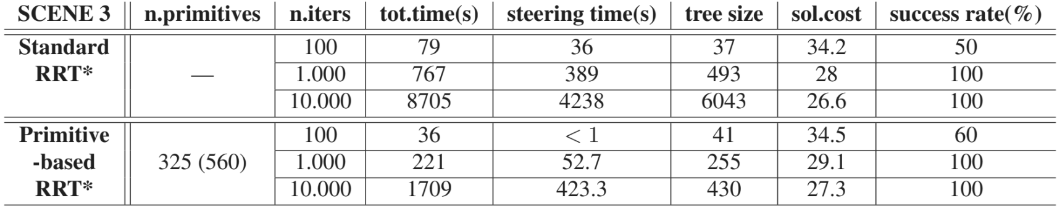
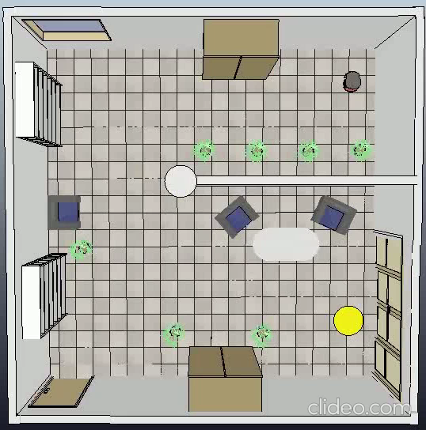
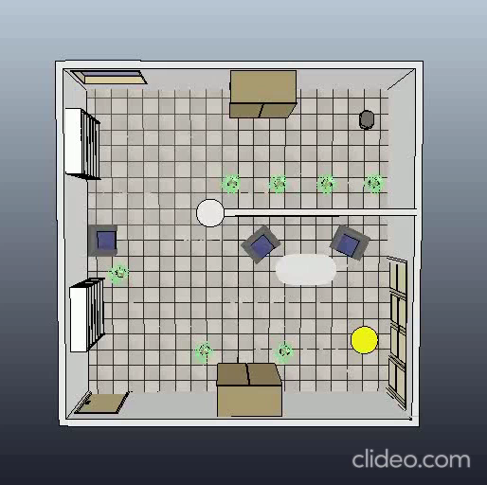
Planning experiments
Classic RRT*
Primitive-based
RRT*
Classic RRT*

Slide 20
Conclusions
Standard RRT*
Primitive-based RRT*
Continuous state space
Slightly lower cost solutions
Higher computational time
Higher success rate
Discretized state space
Slightly higher cost solutions
Lower computational time
Lower success rate
Highly dependent on the number of primitives
Might have problems with narrow passages
Choice depends on user’s needs and computational resources

Slide 21
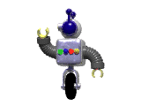
Thanks for your attention

